Slide 1
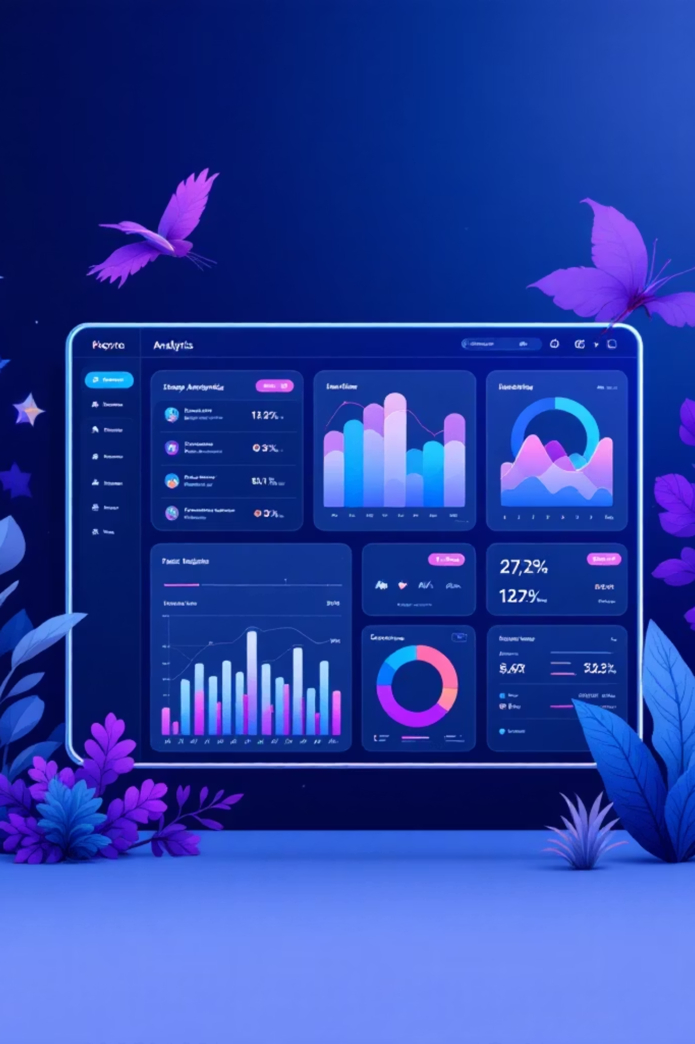
Customer Shopping Behavior Analysis
Uncovering insights from 3,900 purchases to guide strategic business decisions through data-driven analysis of spending patterns, customer segments, and product preferences.

Slide 2
DATASET OVERVIEW
The Foundation: Our Data
3,900
18
37
Total Purchases
Data Points
Missing Values
Transactions analyzed
Features per purchase
In review ratings only
Key Features Captured
Customer demographics: Age, Gender, Location, Subscription Status
Purchase details: Item, Category, Amount, Season, Size, Color
Shopping behavior: Discounts, Previous Purchases, Review Ratings, Shipping Type

Slide 3

PYTHON ANALYSIS
Data Preparation & Cleaning
01
02
Data Loading & Exploration
Missing Data Handling
Imported dataset using pandas, examined structure with df.info() and summary statistics
Imputed 37 missing Review Rating values using median rating per product category
03
04
Feature Engineering
Database Integration
Created age_group bins and purchase_frequency_days columns for deeper analysis
Connected to PostgreSQL and loaded cleaned data for SQL analysis

Slide 4

SQL ANALYSIS
Key Business Questions
We performed structured analysis in PostgreSQL to uncover actionable insights across 10 critical business dimensions.

Slide 5
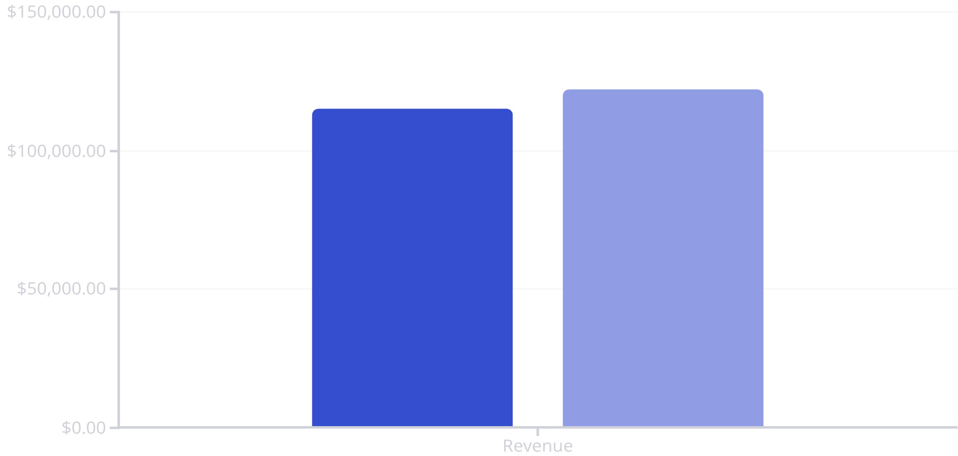
Revenue Insights
Gender Revenue Comparison
Female customers generated slightly higher total revenue than male customers, suggesting targeted marketing opportunities.
Shipping Preferences
Express shipping users showed higher average purchase amounts compared to Standard shipping, indicating premium customer segments.
Male
Female

Slide 6


Subscription Impact
Subscribers Drive Value
Subscribers demonstrate higher average spend and contribute significantly more to total revenue compared to non-subscribers.
Key Finding: Customers with more than 5 purchases show strong correlation with subscription adoption.
68%
5+
Higher Spend
Purchase Threshold
Subscribers vs. non-subscribers
Repeat buyers likely to subscribe

Slide 7



Customer Segmentation
New Customers
Returning Customers
Loyal Customers
First-time buyers exploring product offerings and building initial brand relationship.
Repeat purchasers showing consistent engagement with select product categories.
High-frequency buyers with strong brand affinity and subscription adoption.

Slide 8
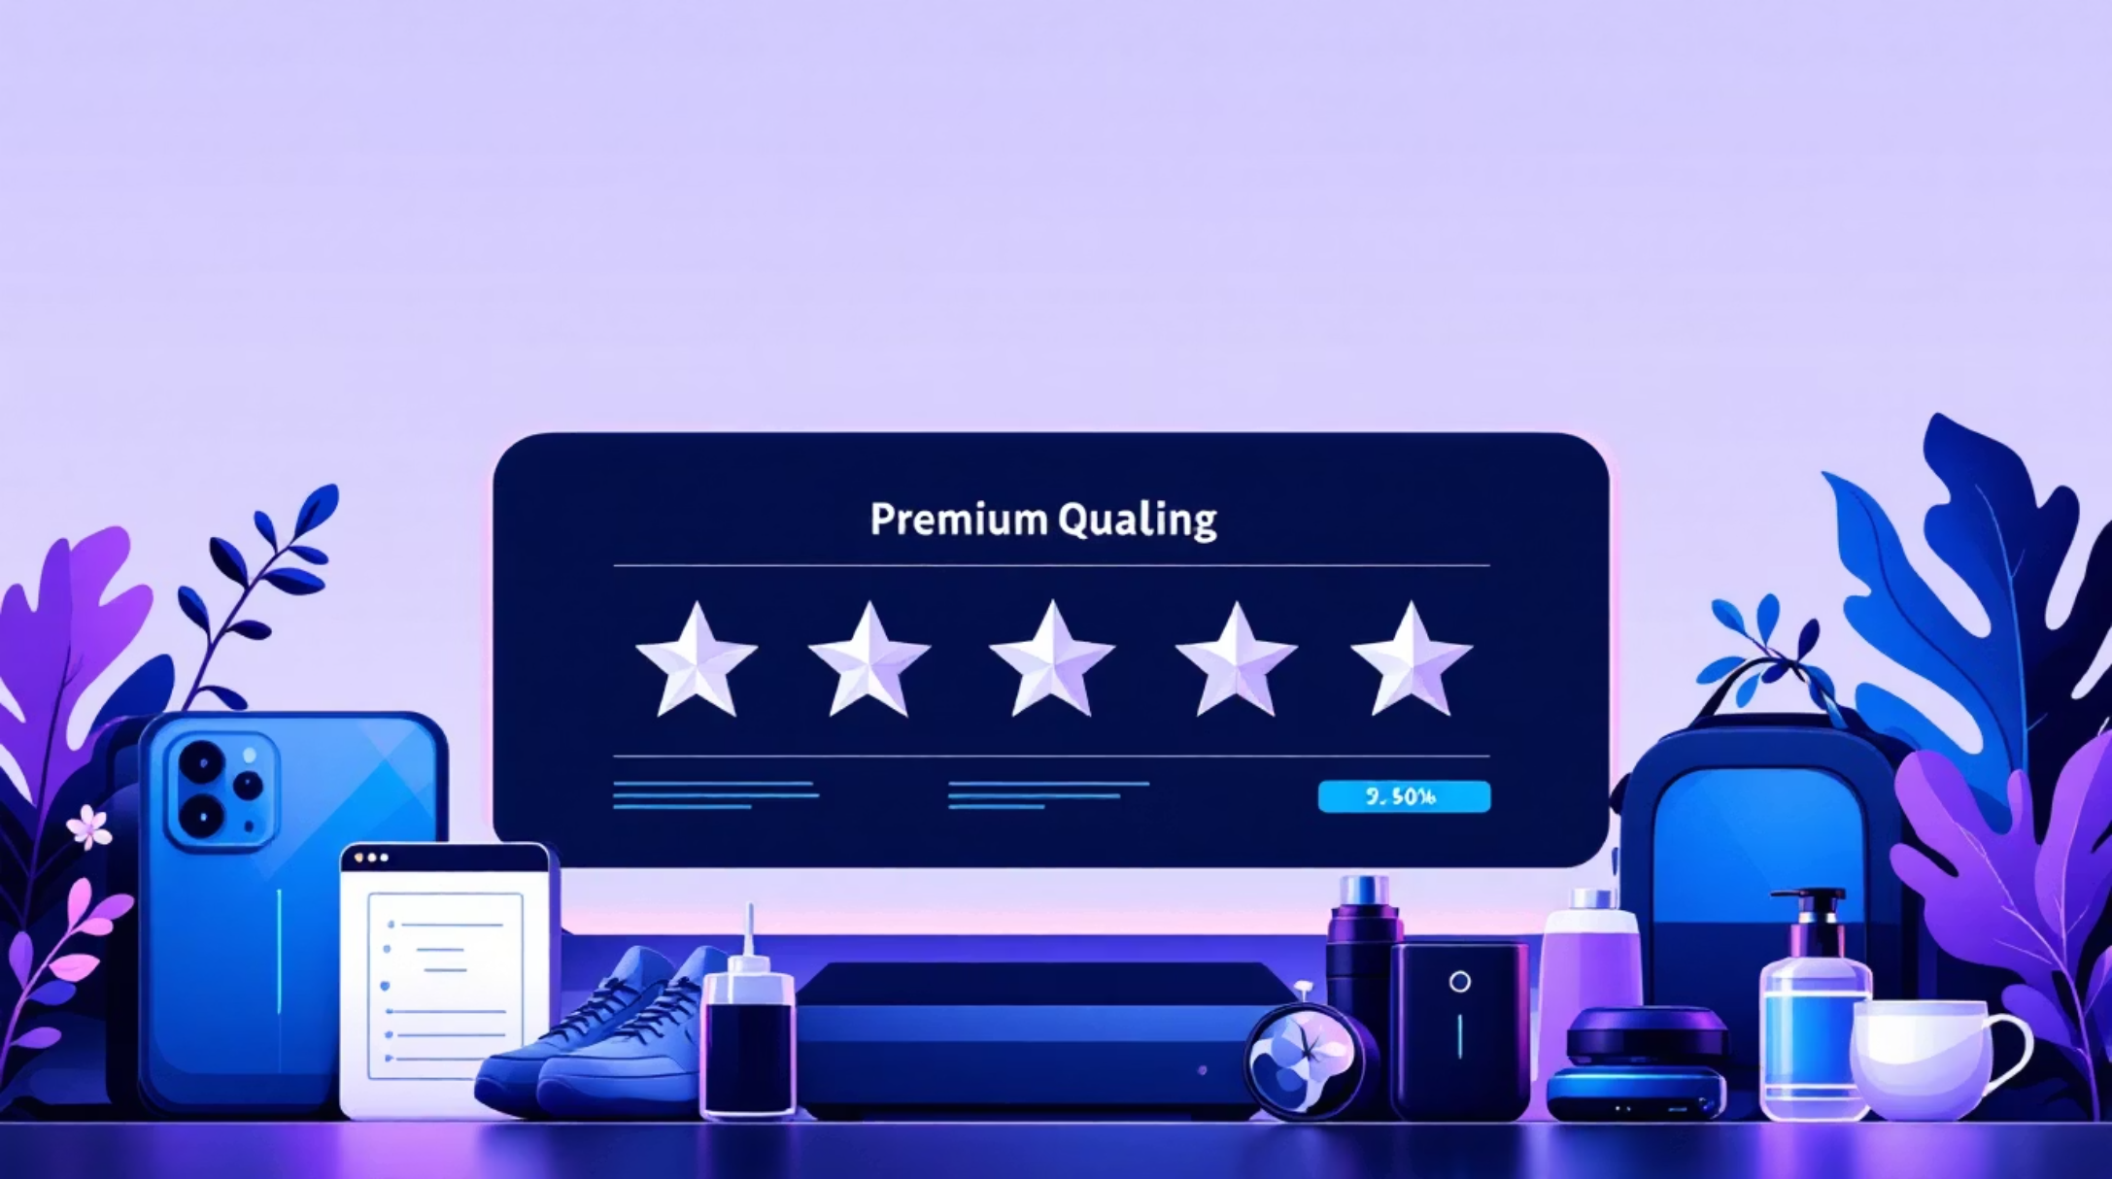
Product Performance
Top-Rated Products
Five products achieved highest average review ratings, indicating strong customer satisfaction and quality perception.
Discount Dependency
Identified 5 products with highest percentage of discounted purchases, revealing price-sensitive categories requiring strategic pricing review.

Slide 9

Power BI Dashboard
Built an interactive dashboard presenting all insights visually, enabling stakeholders to explore data dynamically and make informed decisions in real-time.
Revenue Tracking
Product Analytics
Customer Segments
By gender, age group, and subscription status
Top performers and category insights
Behavioral patterns and loyalty metrics

Slide 10
ACTION ITEMS
Strategic Recommendations
Boost Subscriptions
Customer Loyalty Programs
Review Discount Policy
Promote exclusive benefits and rewards to convert high-frequency buyers into subscribers.
Reward repeat buyers to accelerate their journey into the "Loyal" customer segment.
Balance promotional sales boosts with margin control to optimize profitability.
Product Positioning
Targeted Marketing
Highlight top-rated and best-selling products in marketing campaigns for maximum impact.
Focus efforts on high-revenue age groups and express-shipping users for premium experiences.

